Slide 1
Commas

Slide 2
Commas Separating Adjectives
What is an adjective?
Sometimes, writers use more than one adjective to describe the same noun. In these cases, you may or may not need a comma.

Slide 3
Ralph found the smooth, shiny pebble on the beach.
What part of speech are the underlined words?
What word are they describing?

Slide 4
To decide if adjectives need a comma between them, ask yourself:
1. Does the sentence sound natural with the word "and" between the adjectives?
2. Does the sentence sound natural if you switch the order of the adjectives?
If the answer to both questions is "yes," place a comma between the adjectives.

Slide 5
Ralph found the smooth and shiny pebble on the beach.
Ralph found the shiny, smooth pebble on the beach.

Slide 6
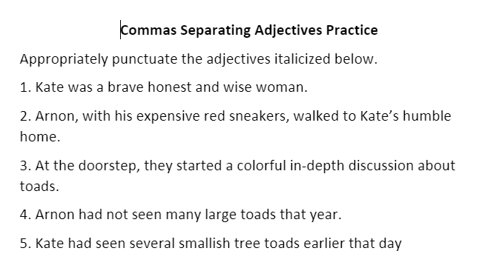

Slide 7
Commas with Introductory Phrases and Clauses

Slide 8
Commas should be used after some introductory words, phrases and clauses.
A. Use commas after introductory verbal phrases.
  Infinitive Phrase (Infinitive = to + verb)
    To win that game, we must be very well prepared.
    Participial Phrase (Participle = verb that ends in –ed or –ing)
    Tired after their long march, the soldiers were ready to sleep.
    Running quickly down the stairs, Mrs. Harris tripped.

Slide 9
Prepositional Phrases
What is a preposition?
What is a prepositional phrase?
Example:
After I left, it started to rain.

Slide 10
Clauses
Independent or Dependent
  Independent Clause – a clause that can stand alone as a sentence.
  Dependent Clause - a group of words with a subject and a verb. It cannot stand alone as a sentence.

Slide 11
Example:
If they want to win, athletes must exercise every day.
What is the dependent clause?
What is the independent clause?

Slide 12
Other Introductory words:
Well, I guess I need to do my homework.
No, I will not do my homework.
Yes, I will do my homework.

Slide 13
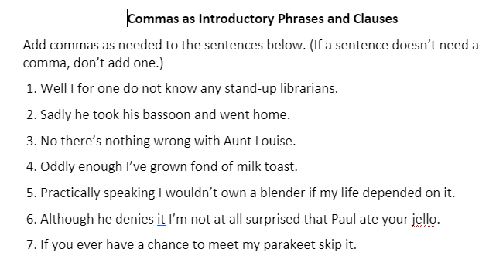

Slide 14
Commas With Dates
When writing a date, a comma is used to separate the day from the month, and the date from the year.
I was born on Sunday, May 12, 1968.
July 4, 1776, was an important day in American history.

Slide 15
Do use a comma if you’re including a day of the week with the date. Note the use of the comma after the date when it appears in the middle of a sentence.
On Friday, October 28th at four o’clock, we’ll have a small gathering in the office kitchen to celebrate Mark’s birthday.
Please come out on Saturday, April 15th, 2017, to show your support for the marathon runners.

Slide 16
When you’re giving only a month and a year, you don’t need a comma.
I haven’t seen this much snow since January 2002.

